Slide 1
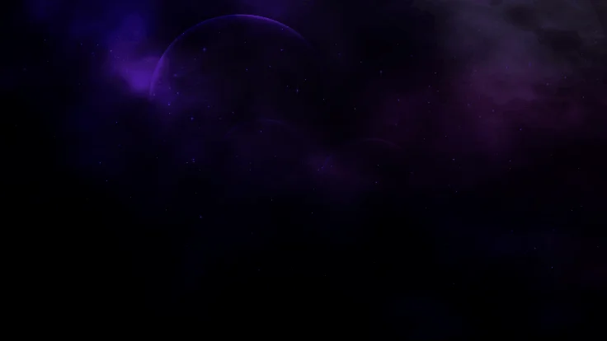
The coders
Presentation

Slide 2
CONTENTS:
Idea
About us
Tech Stack
Implementation

Slide 3



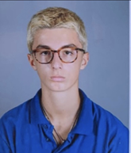
Our Team
Maksim Mateev - developer
Egor Grebennikov - developer
Borislav Petkov- developer
Aleksandar Stanev – scrum trainer

Slide 4
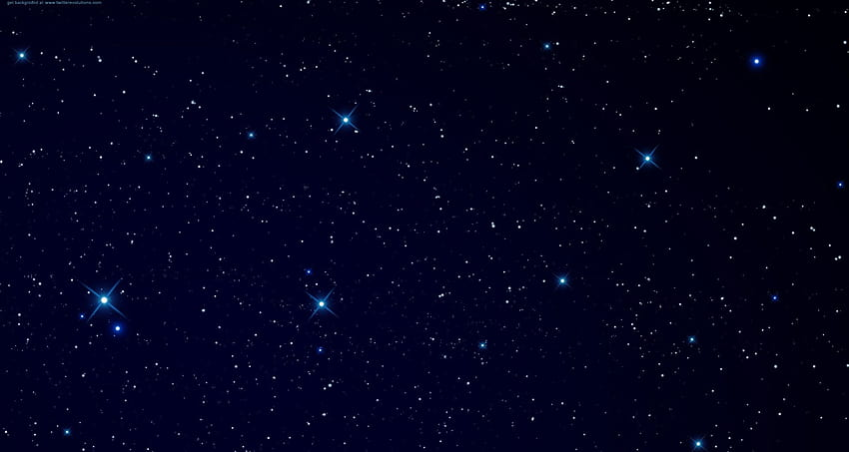
THE IDEA:
The goal of our project is to get people to know more about space and the stars.

Slide 5





Tech Stack

Slide 6
Implementation
We built our application from the ground up in the span of one week, meaning that our project will hopefully be deemed successful.
This time around though, our time for set up and organization could have gone better. That however didn’t discourage us from working stably throughout the rest of our given time.

Slide 7
Thanks for listening !

